Slide 1
Raspberry Pi Assembly Programming
From:
http://www.microdigitaled.com/ARM/ASM_ARM/Software/ARM_Assembly_Programming_Using_Raspberry_Pi_GUI.pdf

Slide 2
Introduction
The Raspberry Pi is an inexpensive credit-card sized Linux computer. At its core is an ARMv6 CPU. The free download Raspbian package (from http://www.raspberrypi.org/downloads/) contains all the software necessary for ARM assembly language programming.
The downloaded package includes Raspbian operating system and several programming language supports. Among them is the GNU Compiler Collection (GCC) which supports programming in C, C++ and assembly languages.

Slide 3
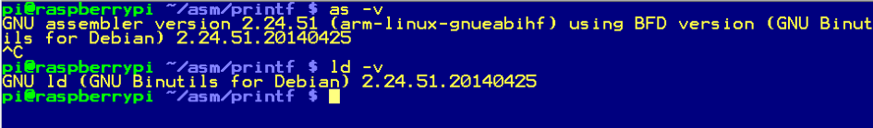
Software Tools
In this document, we will use the commands as (assembler), ld (link loader), and gdb (GNU debugger) from GCC. These are commands of the command line interface that can be executed from the command prompt.
The Raspbian software package comes with two command line text editors nano and vi that may be used to enter and edit the assembly source code. Here are the versions used in this tutorial:

Slide 4
GCC Assembly Syntax
The program is running under Raspbian OS. The OS provides services such as console read/write or file I/O.
Here are some syntax rules for the assembly source file:
Comments are preceded by ‘@’ instead of ‘;’. The assembler also accepts C++ style comments enclosed with ‘/* */’ and ‘//’.
Labels must be followed by a ‘:’.

Slide 5
GCC Assembly Directives
GCC Directive | Explanation
.text | Signifies the beginning of code or constant
.data | Signifies the beginning of read/write data
.global label | Makes the label visible to linker
.extern label | label is declared outside of this file
.word word [,word, word, …] | Declares word (32-bit) data
.double double [,double, …] | Declares double precision floating point (64-bit) data
.space #bytes [,fill] | Declares memory (in bytes) with optional fill
.asciz “ASCII string” | Declares an ASCII string with null termination
.equ symbol, value | Sets the symbol with a constant value
.set variable, value | Sets the variable with a new value
.end | Signifies the end of the program

Slide 6
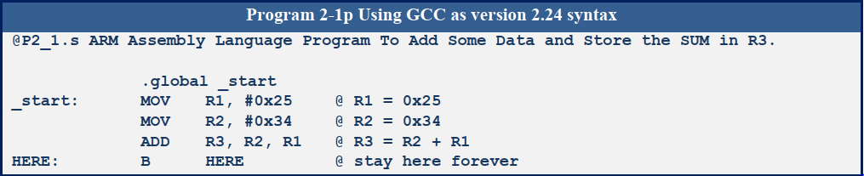
Sample Program
Notes:
Comments either use C-style /* */ or are preceded with ‘@’.
Labels are followed by ‘:’.
GCC linker is expecting a label “_start” for the entry point of the program. This label also must be made global so that it is visible to the linker.

Slide 7
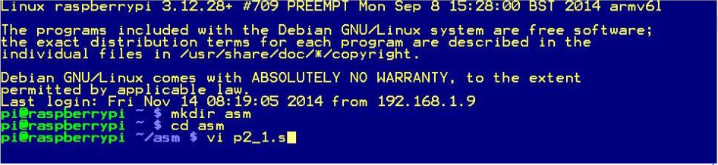
How to Assemble the Program
In this example, we enter the program above into a file name p2_1.s in the $HOME/asm directory,
.
First we make a directory with the name asm, change the current directory to asm and launch the editor vi for the file p2_1.s. We are showing the use of editor vi here but you may use any text editor you prefer.

Slide 8
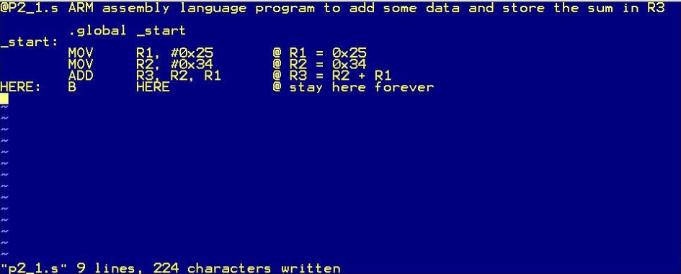
Writing the Program File

Slide 9
Assembling the Program
The program is assembled using command “as –o p2_1.o p2_1.s”. In this command, “as” is the name of the assembler, “–o p2_1.o” tells the assembler to create the output object file with the name p2_1.o, and lastly, “p2_1.s” is the assembly source file name (see below).
Like many Unix programs, it produces no output to the console when the program runs without errors.

Slide 10
Linking the Program
Linker takes one or more object files and creates an executable file. To run the linker, use command “ld –o p2_1 p2_1.o”. In this command, “ld” is the name of the linker program, “–o p2_1” tells the linker to produce the output executable file with the name p2_1, and lastly, “p2_1.o” is the input object file name.
Again, the linker produces no output to the console when there are no errors.

Slide 11

Executing the Program
To execute the program, type the command “./p2_1” at the prompt. It tells the shell to execute the program named p2_1 at the current directory.
Recall the last instruction in the program is an infinite loop. After executing the first three instructions, the program is stuck at the infinite loop that consumes 100% of the CPU time. An infinite loop is typical for a program in a simple embedded system without an operating system.

Slide 12
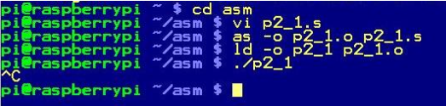
Terminating the Program
For now, type Ctrl-C to terminate the program and get the prompt back.

Slide 13
Proper Termination
As an application running under a multitasking operating system, the program should be terminated when done. Otherwise, the program running a dummy infinite loop will consume the CPU time and slow down all the other programs.
To terminate a program, replace the dummy infinite loop at the end with:
MOV R7, #1
SVC 0

Slide 14
Explanation of Termination
The number 1 placed in Register 7 tells the operating system to terminate this program. The instruction “SVC 0” is the system call, that transfers the program execution to the operating system. If you place a different number in R7, the operating system will perform a difference service.
After replacing the dummy infinite loop with the system call to end the program, run the assembler and linker again. This time after you execute the program, the program will terminate by itself and the prompt reappears immediately without user intervention.

Slide 15
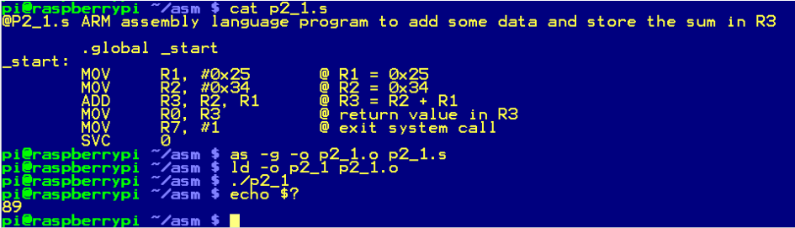
Program Output
When an assembly program terminates, it can leave an exit code in Register 0 before the exit system call is made. After the program exit, the user may retrieve the exit code by reading the shell variable “$?”. This is a simple method for a single integer output of a program.

Slide 16
Using GDB
GDB (GNU Debugger) is a great tool to use to study the assembly programs. You can use GDB to step through the program and examine the contents of the registers and memory.
In the following example, we will demonstrate how to control the execution of a program using GDB and examine the registers and memory content.

Slide 17
Preparation to Use GDB
To use GDB, you must add “-g” to the assembler command line. Then the symbols and line numbers of the source code will be preserved in the output executable file and the debugger will be able to link the machine code to the source code line by line.
as -g -o p2_1.o p2_1.s
The linker command stays the same.

Slide 18
Launching GDB
To launch the GNU Debugger, type the command gdb followed by the executable file name:
gdb p2_1
After displaying the license and warranty statements, the prompt is shown as (gdb).

Slide 19
GDB Commands
GDB has a wealth of commands. I will only touch a few here. At the gdb prompt, you only need to type the minimal number of characters to be distinctive for the command. I will show the full command but underscore the minimal required characters.

Slide 20
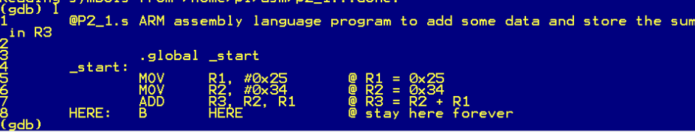
List source code
To list the source code, the command is:
list
The list command displays up to 10 lines of the source code with the line number in front of each line. To see the next 10 lines, just hit the Enter key.

Slide 21
Set a breakpoint
The command to set a breakpoint is
break n
where n = line number. For example, to set a breakpoint at line 6:
b 6

Slide 22
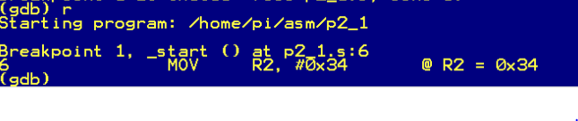
Run the program
To start the program you are debugging, use command
run
Program execution will start from the beginning until it hits the breakpoint. The line where the breakpoint was set will be displayed. Remember, this instruction has not been executed yet.

Slide 23
Examine Registers
We can examine the general purpose registers using the command:
info registers
The display shows the register names, the contents in hexadecimal, and the contents in decimal. Registers that hold only addresses will show their values only in hexadecimal.

Slide 24
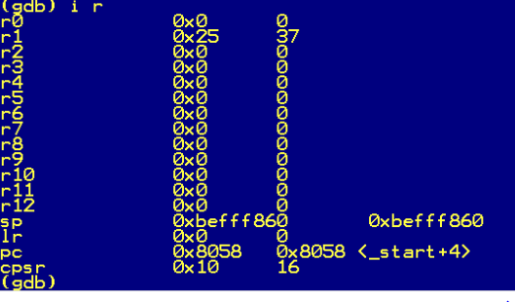
Examine Registers (cont.)

Slide 25
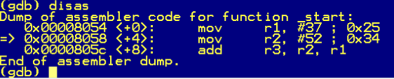
Disassemble machine code
The command to disassemble the machine code back to assembly instructions is:
disassemble
The result may differ from the original source code. The breakpoint is marked by an arrow at the left margin.

Slide 26
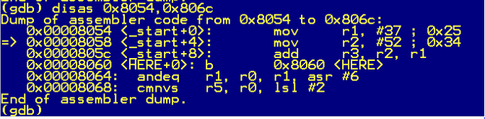
Disassemble machine code (cont.)
The disassemble command also takes a starting address and an ending address separated by a comma such as:
disas 0x8054, 0x806c

Slide 27
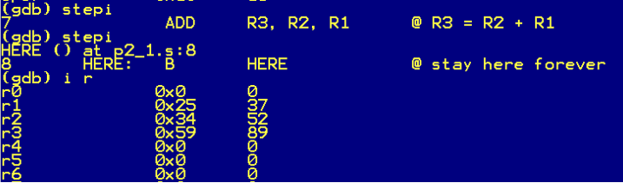
Step through the instructions
The command to step one instruction at a time is:
stepi

Slide 28
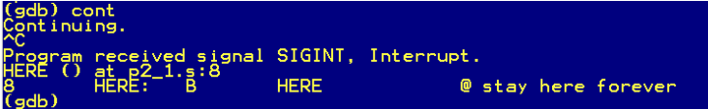
Continue program execution
The command to continue from where execution was halted is:
continue
Since there are no more breakpoints left, the program will hit the infinite loop, and you must press Ctrl-C to exit.

Slide 29
Examine Memory
The command to examine the memory is
x/nfs address
where n=number of items, f=format, and s=size.
Options | Possible values
Number of items | any number
Format | octal, hex, decimal, unsigned decimal, bit, float, address, instruction, char, and string
Size | byte, halfword, word, giant (8-byte)

Slide 30
Examine Memory (cont.)
For example, to display eight words in hexadecimal starting at location 0x8054, the command is
x/8xw 0x8054

Slide 31
Exit GDB
To exit GDB, the command is
quit

Slide 32
Summary
We have seen several tools for assembly language programming available on the Raspberry Pi:
nano, a text editor
as, the assembler
ld, the linker
gdb, the debugger
We will get better acquainted with these tools as we use them to develop our own programs.

